Slide 1


ADICHUNCHANAGIRI INSTITUTE OF TECHNOLOGY, CHIKMAGALUR
DEPARTMENT OF COMPUTER SCIENCE & ENGINEERING
PROJECT PHASE-2 SEMINAR ON
“HUMAN FACE SHAPE CLASSIFICATION AND PERSONALIZED RECOMENDATIONS”
Under the Guidance of
Mr. Gopalakrishna C B.E., M.E., (Ph.D), LMISTE.
Associate Professor
Department of Computer Science & Engineering,
Presented By
Dhanya H M(4AI20CS029) Sahana M(4AI20CS083)
Kavana N(4AI20CS043) Soujanya D H(4AI20CS102)

Slide 2
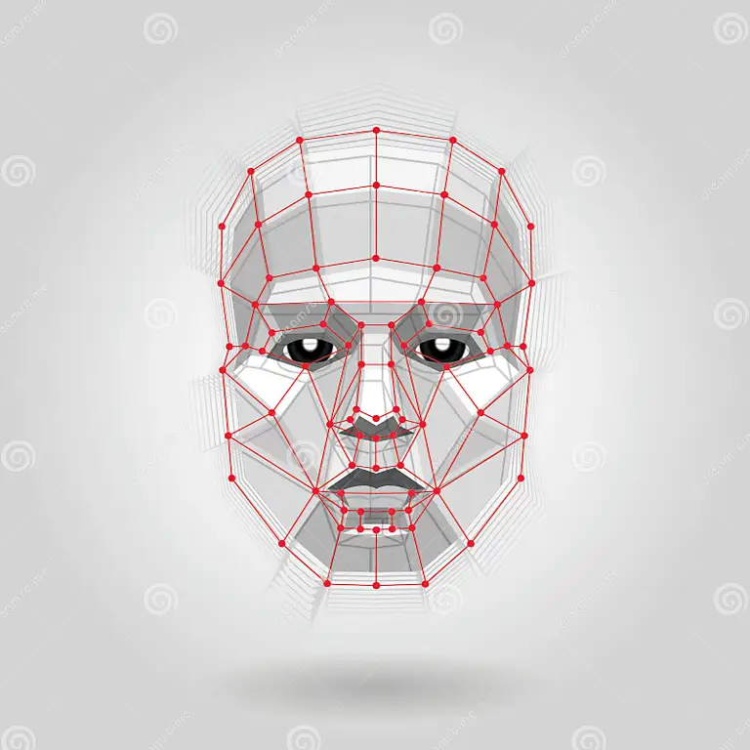
“Human face shape Classification”
Heart
Oval
Square
Round
Diamond
Oblong

Slide 3
ABSTRACT
Face shape classification is useful for recommending hairstyle, eyeglasses, etc.
It also plays an important role in finding similar faces for cosmetic or dental reconstruction treatments and procedures.
We used photos freely available online, automatically annotated all of them with facial landmarks using machine learning.
It calculates key distances, ratios and angles for uniquely classifying faces into five geometric shapes i.e. heart, oblong, oval, round and square.
The results show that the proposed method, based on calculations from facial landmarks gives effective results in classifying face shapes.

Slide 4
CONTENTS
1. INTRODUCTION
Motivation
Problem Statement
Objective
Scope
Review of Literature
SYSTEM REQUIREMENT SPECIFICATION
Hardware Requirements
Software Requirements
HIGH-LEVEL DESIGN
System Architecture
Use case Diagram
Flowchart
4. DETAIL DESIGN
5 .IMPLEMENTION
Pseudo Code for each module
6. SYSTEM TESTING
Unit Test Cases
7. RESULTS AND ANALYSIS
Snapshots
8. CONCLUSION AND FUTURE SCOPE
REFERENCES

Slide 5
INTRODUCTION
Face shape classification is an essential tool for exploiting facial image data and has a wide range of applications that include grouping a collection of face images and indexing for face retrieval.
Face shape identification has a great impact on security and convenience, as it is currently being used in multiple applications to make the world safer, smarter, and more convenient.
Some applications include smarter advertising like recommending hairstyles or sunglasses that suit customer’s face shape.
The original goal of this project was to develop a framework to impute the deformed parts of a given deformed face image and find a similar not-deformed face to the deformed face for dental/facial reconstruction procedures.

Slide 6
MOTIVATION
Having prior knowledge about our own facial shapes helps us make better choices about apparel and fashion.
Our ability to style ourselves to look our best without consulting an expert on how our clothing choices relate to our face shape is helped by the coherence of our face shape.
By accurately detecting users' face shapes and providing personalized recommendations, companies can significantly improve the user experience.
Face shape detection and personalized recommendations streamline the decision-making process for users by presenting them with options that are most relevant to their needs
Personalized recommendations not only help users find products they are interested in but also present opportunities for cross-selling and up-selling

Slide 7
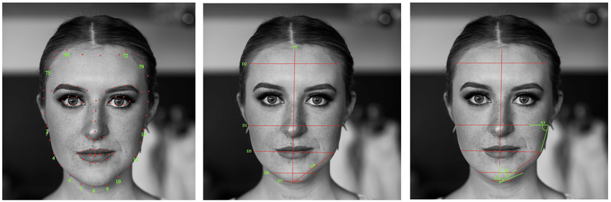
PROBLEM STATEMENT
“ To design and develop a reliable and user-friendly Face Shape Predictor that can accurately analyse facial features from input images, categorize individual’s face shapes, and provide personalized recommendations”.
1 . INPUTS:
User Photo: The primary input is a user's facial photograph uploaded through a web or mobile interface. This photo serves as the basis for face shape prediction.

Slide 8
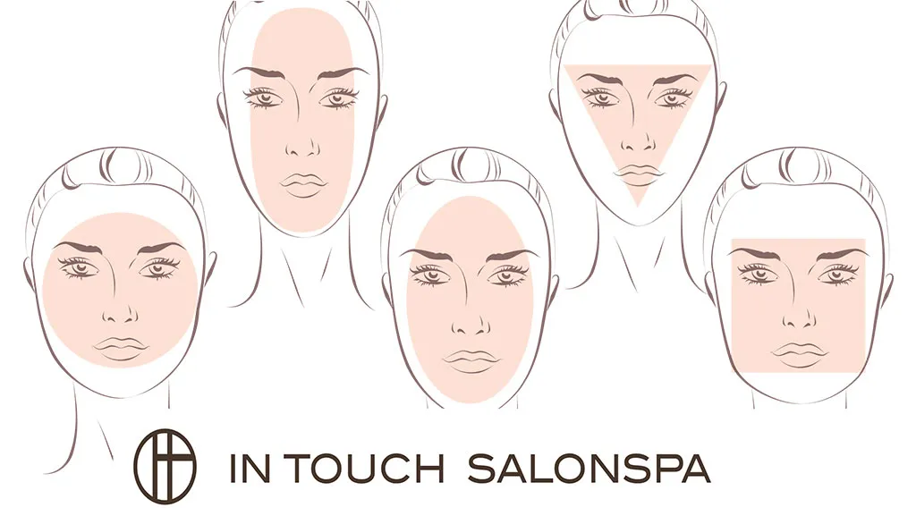
2. PROCESS:
Preprocessing:
Image resizing.
RGB to Grayscale conversion – rgb2gray().
Noise reduction - Median Filtering.
Image Sharpening – High Pass Filtering.
Feature Extraction:
Harr Cascade(face shape detection).
Classification:
Convolutional Neural Network(CNN).

Slide 9
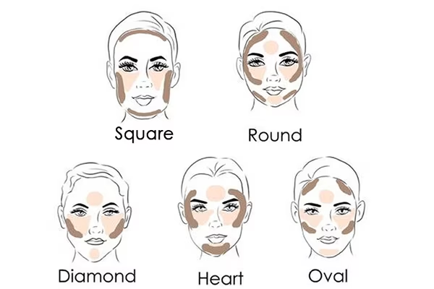
3.OUTPUT:
Face Shape Prediction: The primary output is the predicted face shape, presented to the user, such as "Your face shape is oval."
Personalized Recommendations: The system provides a list of recommendations tailored to the user's face shapes like contour and different styles suggestions also it provides sunglasses, hairstyles, eyebrow suggestions.

Slide 10
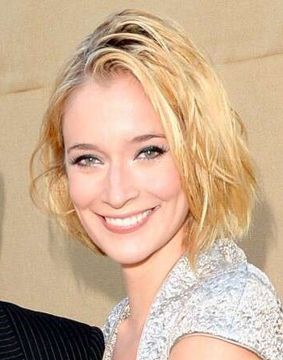
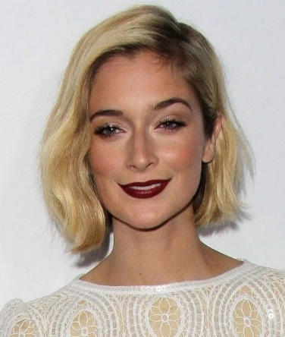
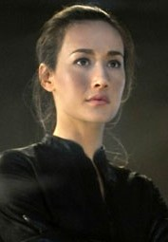
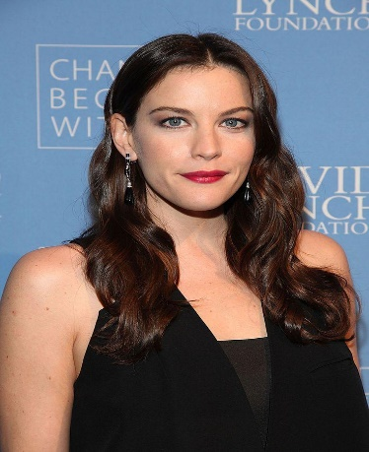
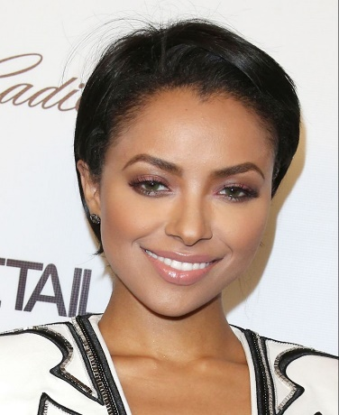
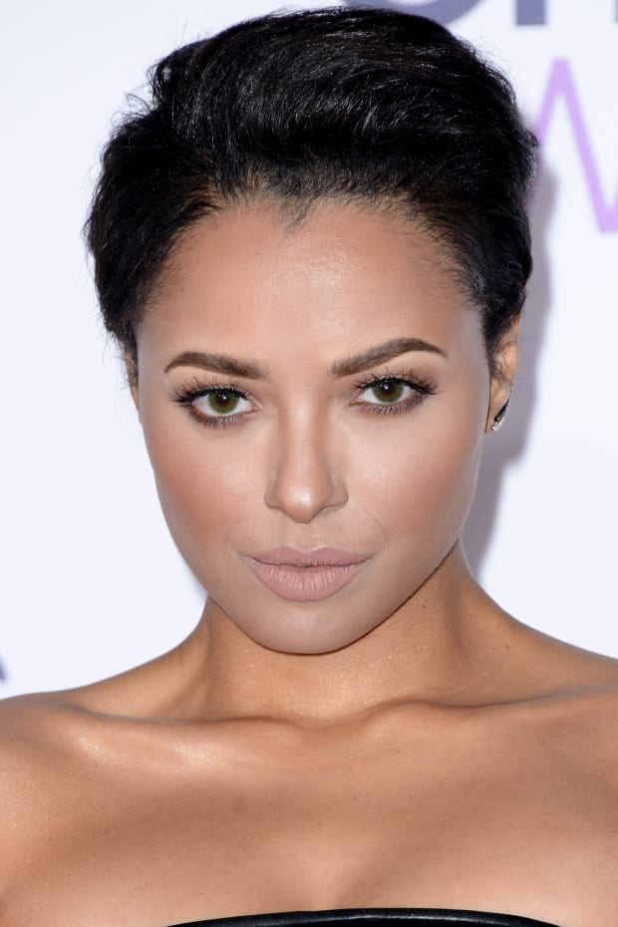
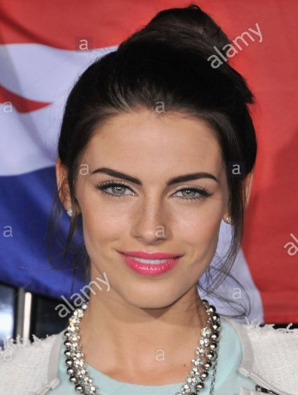
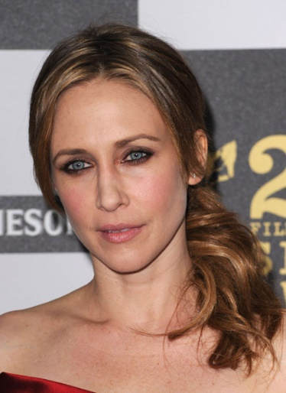
DATASETS
Heart
Oblong

Slide 11
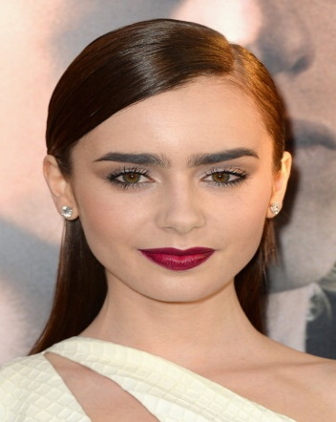
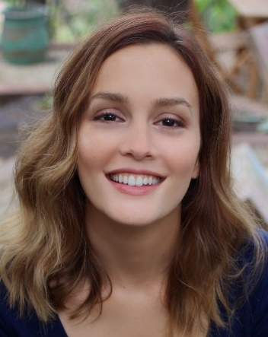
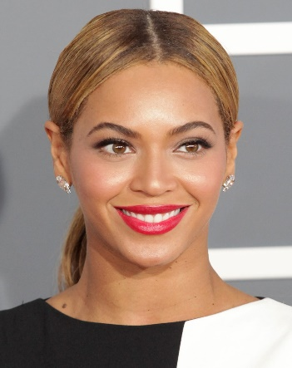
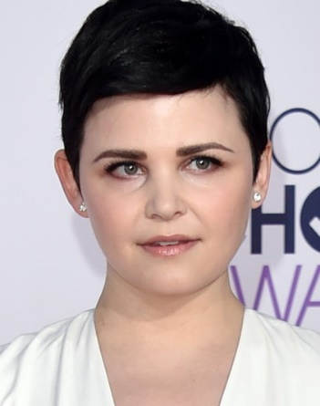
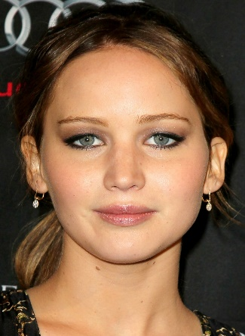
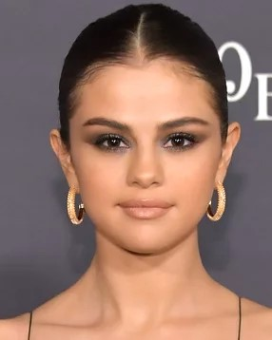
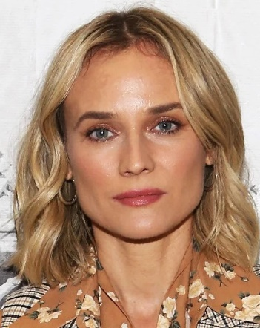
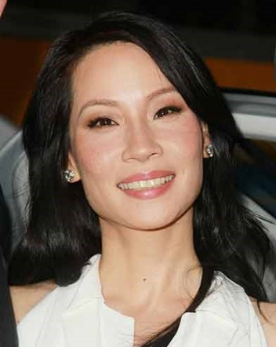
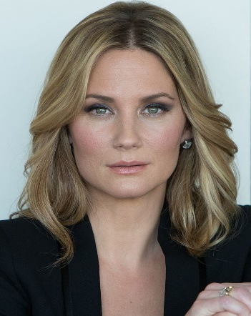
Oval
Round
Square

Slide 12
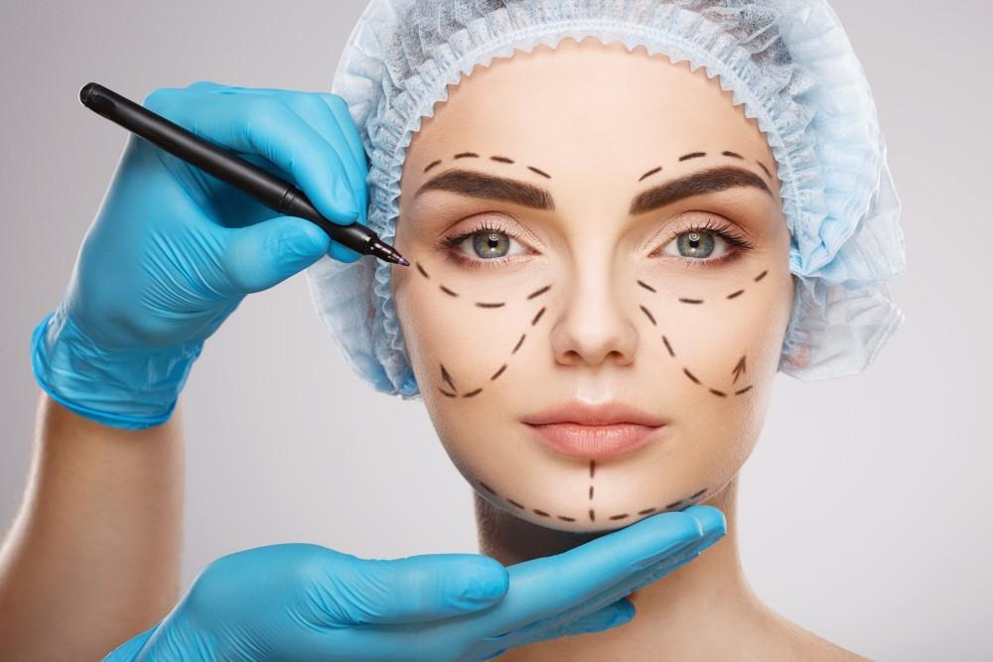
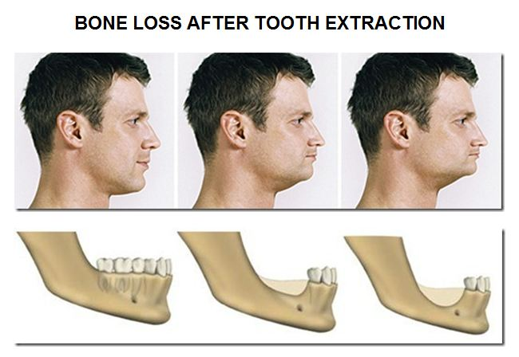
SCOPE OF THE PROJECT
Facial reconstruction (Plastic surgery)
Dental reconstruction (Tooth Alignment)
Cosmetic suggestions (contour and highlight)

Slide 13
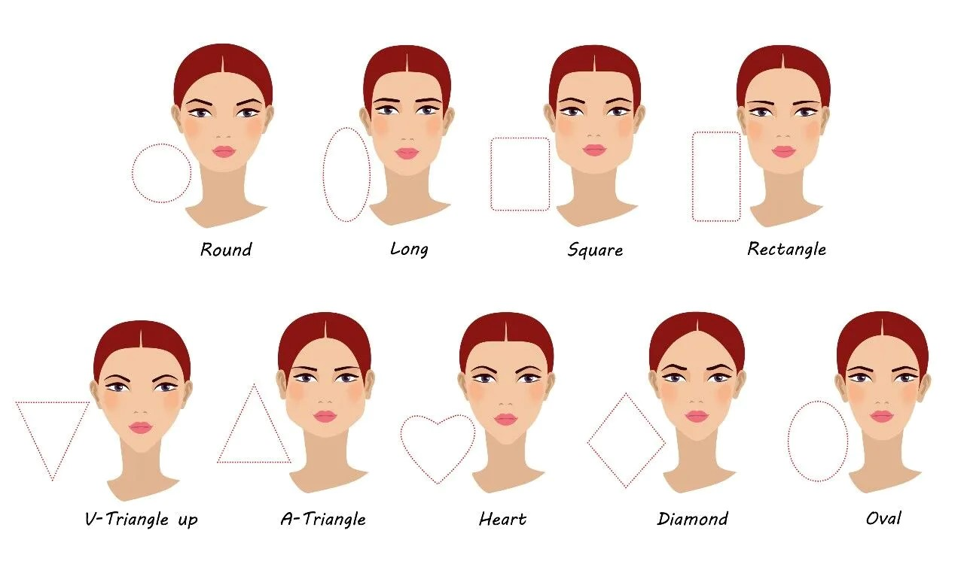
OBJECTIVES
To detect the human face and make classifications.
To detect the Landmarks by using imputation techniques from the given image.
To predict the shape, whether it is round, oval, square, heart, oblong.
To provide personal recommendations based on the face shape.

Slide 14
LITERATURE SURVEY
Sl. No | Title and Published Year | Authors | Description | Remarks
1 | Facial Shape Analysis and Prediction: A Comprehensive Review. Published in year 2021 | John Smith, Jane Doe | This comprehensive review paper provides an overview of various methodologies used in facial shape analysis, including geometric and deep learning approaches. | It summarizes the state-of-the-art techniques in facial feature extraction and shape prediction.
2 | Deep Learning-Based Facial Feature Extraction for Face Shape Prediction. Published in year 2018 | Mary Johnson, Robert Lee | The authors propose a deep learning approach to extract key facial features for face shape prediction. | They employ convolutional neural networks (CNNs) for feature extraction, which is a relevant technique for your project's face shape identification.
3 | Fashion and Beauty Recommendations for Personalized Styling. Published in year 2020 | Emily Wang, David Chen | This paper discusses the methodologies used in fashion and beauty recommendation systems. | Understanding these methods can help inform the recommendation component of your project.

Slide 15
LITERATURE SURVEY Cont…
Sl. No | Title and Published year | Authors | Description | Remarks
4 | Privacy-Preserving Facial Analysis for User-Centric Applications. Published in year 2022 | Lisa Garcia, Michael Brown | This recent paper explores privacy-preserving techniques in facial analysis, which can be crucial for ensuring user data protection in your project. | It discusses methods like federated learning and secure multiparty computation.
5 | Gender and Ethnicity Classification in Facial Recognition. Published in year 2018 | Ahmed Ali, Fatima Khan | This paper investigates the challenges and methods for gender and ethnicity classification in facial recognition. | Understanding these issues can help you in ensuring your face shape predictor is inclusive and accurate for a diverse user base.
6 | Improving Self-Esteem Through Personalized Image Enhancement. Published in year 2017 | Sarah Williams, James Miller | This study explores the psychological aspects of image enhancement and its impact on self-esteem. | It can provide valuable insights into the potential positive outcomes of your project.

Slide 16
SYSTEM REQUIREMENT
HARDWARE REQUIREMENTS:
System : intel i3 2.4 GHz.
Hard Disk : 500 GB
RAM : 4 GB
SOFTWARE REQUIREMENTS:
Operating system : Windows 7
Software Tool : Open CV or Python
Coding Language : Python
Toolbox : Image processing toolbox.

Slide 17
HIGH-LEVEL DESIGN
Architecture Diagram
Input Image
Pre-processing
Feature Extraction
Feature Selection
Classification Using CNN
Predicted Human Face Shape and Recommendation
Figure 1 : Architecture Diagram of Human Face Shape Classification

Slide 18
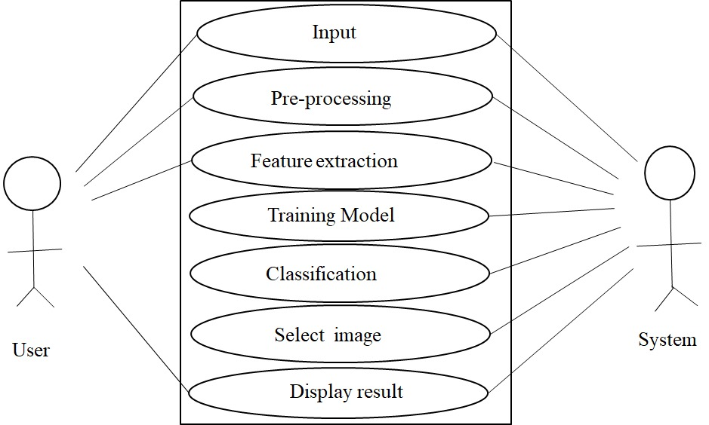
HIGH-LEVEL DESIGN
Use case Diagram
Figure 2 : Use case diagram

Slide 19
HIGH-LEVEL DESIGN
Flow Chart of face shape classification.
Start
Input Images
Split dataset
Train
Test
Pre-processing
no
Feature extraction
CNN model
yes
Predict results
Stop
Figure 3 : Flow Chart of Human Face Shape Classification

Slide 20
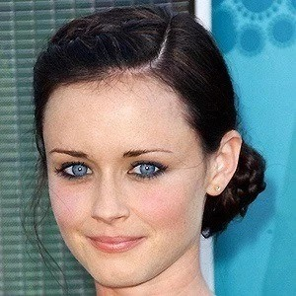
IMAGE ACQUISITION
Image : oval.jpg
Dimension : 300 x 300
Width : 300 pixels
Height : 300 pixels
Type of file : JPG file (.jpg)
Size : 24.7 KB

Slide 21
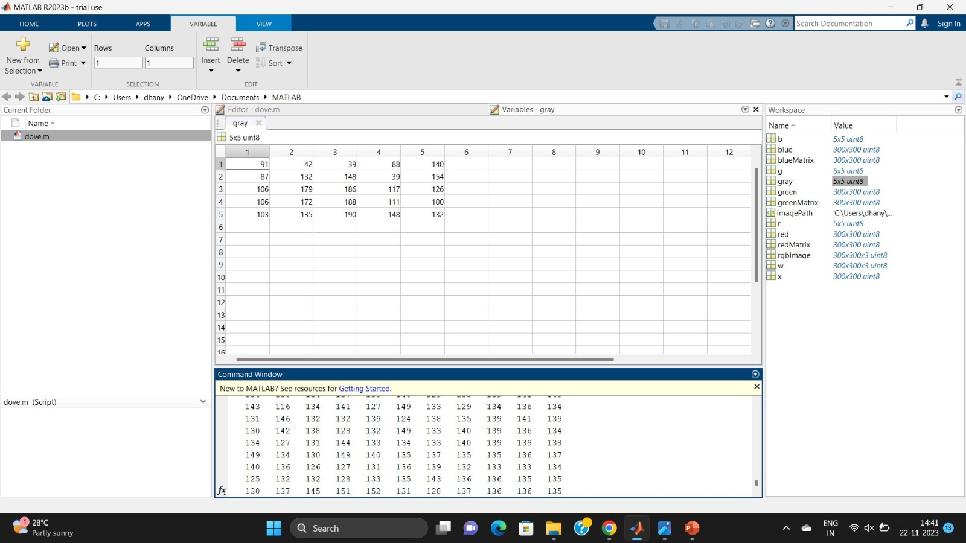
BOARD WORK
Pre-Processing
1.Image Resizing
w=imread(‘oval.jpg’);
red=w(:,:,1);
green=w(:,:,2);
blue=w(:,:,3);
r=imresize(red,[5,5]);
g=imresize(green,[5,5]);
b=imresize(blue,[5,5]);

Slide 22
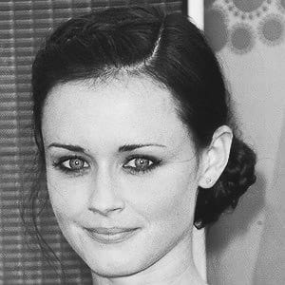
2 .Conversion from RGB to Grayscale
The formula:
0.2989*R+0.5870*G+0.1140*B
RED COMPONENT
GREEN COMPONENT
BLUE COMPONENT
74 | 39 | 44 | 56 | 59
79 | 158 | 174 | 33 | 82
101 | 212 | 216 | 140 | 75
96 | 207 | 228 | 125 | 43
83 | 153 | 233 | 130 | 46
98 | 43 | 37 | 99 | 169
91 | 124 | 139 | 41 | 180
110 | 168 | 176 | 109 | 145
112 | 159 | 175 | 105 | 120
112 | 130 | 176 | 155 | 164
98 | 49 | 42 | 116 | 205
88 | 111 | 128 | 45 | 208
103 | 147 | 157 | 97 | 165
106 | 142 | 156 | 99 | 144
106 | 114 | 150 | 162 | 194
91 | 42 | 39 | 88 | 140
87 | 132 | 148 | 39 | 154
106 | 179 | 186 | 117 | 126
106 | 172 | 188 | 111 | 100
103 | 135 | 190 | 148 | 132

Slide 23
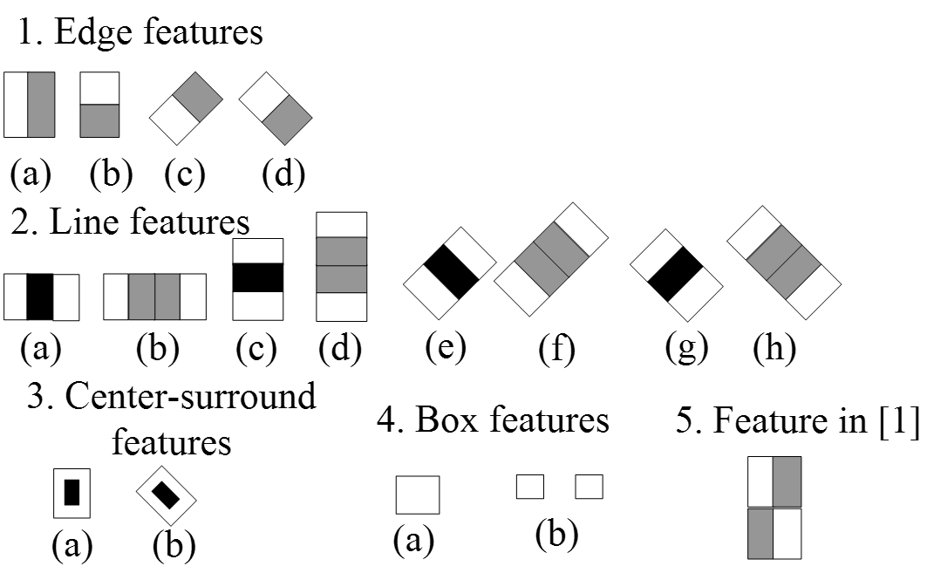
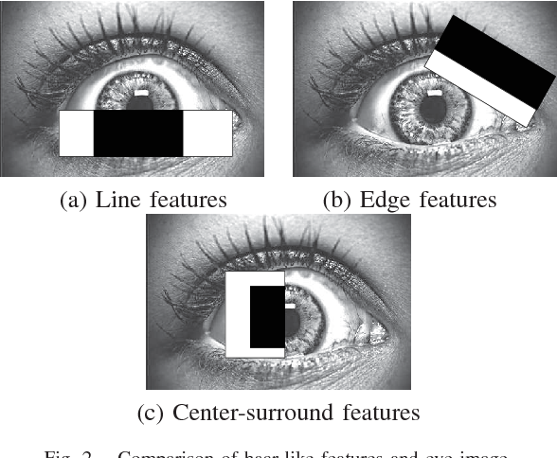
3.Haar cascade
Face recognition
Template matching
Haar cascade is an object detection algorithm used to identify faces in an image or real time video. The algorithm is given a lot of positive images consisting of faces, and a lot of negative images not consisting of any face to train on them.

Slide 24
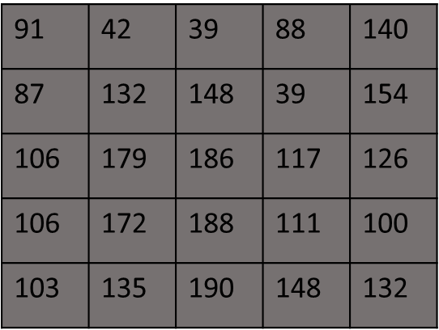
Formula:
Sum of the dark pixels/number of dark pixels – Sum of the light pixels/number of the light pixels
GRAY MATRIX
REARRANGED MATRIX
39 | 39 | 42 | 87 | 88
91 | 100 | 103 | 106 | 106
111 | 117 | 126 | 132 | 132
135 | 140 | 148 | 148 | 154
172 | 179 | 186 | 188 | 190
Median = 126
(2030 / 13) - (1029 / 12)
= 156.15 - 85.75
= 70.4 (haar value)

Slide 25
3. Noise removal
Noise removal algorithm is the process of removing or reducing the noise from the image. The noise removal algorithms reduce or remove the visibility of noise by smoothing the entire image leaving areas near contrast boundaries.
Median Filtering : The formula : k = M+1 /2
The median filter is a non-linear digital filtering technique, often used to remove noise from an image or signal.
Here 0’s are appended at the edges and corners to the matrix which is the representation of the grey scale image.
Then for every3*3 matrix, arrange elements in ascending order, then find median/middle element of those 9 elements, and write that median value to that particular pixel position.

Slide 26
Median Filtering
Append 0's at edges and corners:
Original matrix:
0 | 0 | 0 | 0 | 0 | 0 | 0
0 | 91 | 42 | 39 | 88 | 140 | 0
0 | 87 | 132 | 148 | 39 | 154 | 0
0 | 106 | 179 | 186 | 117 | 126 | 0
0 | 106 | 172 | 188 | 111 | 100 | 0
0 | 103 | 135 | 190 | 148 | 132 | 0
0 | 0 | 0 | 0 | 0 | 0 | 0
Enhanced Matrix:
91 | 42 | 39 | 88 | 140
87 | 132 | 148 | 39 | 154
106 | 179 | 196 | 117 | 126
106 | 172 | 188 | 111 | 100
103 | 135 | 190 | 148 | 132
0 | 42 | 39 | 39 | 0
87 | 106 | 117 | 126 | 88
106 | 148 | 148 | 126 | 100
106 | 172 | 172 | 132 | 111
0 | 106 | 135 | 111 | 0
Fig 4: Noise filtering using Median Filter

Slide 27
Thresholding
Considering each pixel values , if the pixel value is greater than or equal to the threshold T, retain it. Else, replace the value by 0.
Here, the value of T can be manipulated in the frontend, to suit the varying needs of different images. We use trial and error method here.
Original matrix
Enhanced Matrix
0 | 42 | 39 | 39 | 0
87 | 106 | 117 | 126 | 88
106 | 148 | 148 | 126 | 100
106 | 172 | 172 | 132 | 111
0 | 106 | 135 | 111 | 0
0 | 0 | 0 | 0 | 0
0 | 0 | 0 | 0 | 0
0 | 148 | 148 | 0 | 0
0 | 172 | 172 | 0 | 0
0 | 0 | 0 | 0 | 0
Suppose T=148
Fig 5: Thresholding using Basic global thresholding

Slide 28
High-Pass Filtering
Image Sharpening :
Image sharpening refers to any enhancement technique that highlights edges and fine details in an image. Increasing yields a more sharpened image.
High-Pass Filtering :
A high-pass filter can be used to make an image appear sharper. These filters emphasize fine details in the image.
The formula : fsharp(x, y) = f (x, y) + k(f (x, y) − fsmooth(x, y))

Slide 29
High-Pass Filtering-1
Original matrix:
Filtered matrix :
0 0 0 0 0 0 0
0 | 0 | 0 | 0 | 0
-16 | -33 | -33 | -16 | 0
-36 | 77 | 77 | -36 | 0
-36 | 101 | 101 | -36 | 0
-19 | -38 | -38 | -19 | 0
0
0
0
0
0
0 | 0 | 0 | 0 | 0
0 | 0 | 0 | 0 | 0
0 | 148 | 148 | 0 | 0
0 | 172 | 172 | 0 | 0
0 | 0 | 0 | 0 | 0
0
0
0
0
0
-1 | -1 | -1
-1 | 8 | -1
-1 | -1 | -1
X 1/9
After rejecting negatives:
0 0 0 0 0 0 0
0 | 0 | 0 | 0 | 0
0 | 0 | 0 | 0 | 0
0 | 77 | 77 | 0 | 0
0 | 101 | 101 | 0 | 0
0 | 0 | 0 | 0 | 0
Fig 6 : Image Sharpening using High-Pass Filter.

Slide 30
High-Pass Filtering-2
Boundary extension at edges and corners :
Filtered matrix :
0 0 0 0 0 0 0
0
0
0
0
0
0 | 0 | 0 | 0 | 0
-9 | -17 | -17 | -9 | 0
-20 | 37 | 37 | -20 | 0
-20 | 61 | 61 | -20 | 0
-11 | -22 | -22 | -11 | 0
0 | 0 | 0 | 0 | 0
0 | 0 | 0 | 0 | 0
0 | 77 | 77 | 0 | 0
0 | 101 | 101 | 0 | 0
0 | 0 | 0 | 0 | 0
0
0
0
0
0
-1 | -1 | -1
-1 | 8 | -1
-1 | -1 | -1
X 1/9
After rejecting negatives:
0 | 0 | 0 | 0 | 0
0 | 0 | 0 | 0 | 0
0 | 37 | 37 | 0 | 0
0 | 61 | 61 | 0 | 0
0 | 0 | 0 | 0 | 0
0 0 0 0 0 0 0
Fig 7 : Image Sharpening using High-Pass Filter.

Slide 31
Convolution Neural Network(CNN)
Convolutional Neural Network (CNN) is a class of deep neural networks which is applied for analysing visual imagery.
Convolution preserves the relationship between pixels by learning image features using small squares of input data.
It is a mathematical operation that takes two inputs such as image matrix and a filter or kernel.
Each input image will be passed through a series of convolution layers with filters (kernels) to produce output feature maps.
A typical CNN architecture consists of three well-known processing layers.
1) A convolution layer, where various feature maps are produced when different kernels are applied to the input data.

Slide 32
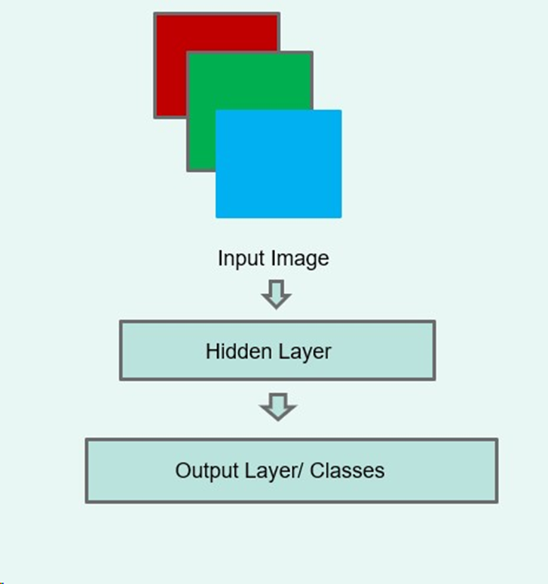
2) A pooling layer, which is used for the selection of maximum activation considering small neighborhood feature maps received from the previous convolution layer; the goal of this layer is to achieve translation invariance to some extent and dimensionality reduction.
3) A fully connected layer which models high-level information from the input data and constructs its global representation. This layer follows numerous stacks of convolution and pooling layers, thus resulting in a high level representation of the input data.

Slide 33
1.Convolutional Neural Network
0 | 0 | 0 | 0 | 0
0 | 0 | 0 | 0 | 0
0 | 37 | 37 | 0 | 0
0 | 61 | 61 | 0 | 0
0 | 0 | 0 | 0 | 0
-37
1 | 0 | -1
1 | 0 | -1
1 | 0 | -1
X
0 | 0 | 0 | 0 | 0
0 | 0 | 0 | 0 | 0
0 | 37 | 37 | 0 | 0
0 | 61 | 61 | 0 | 0
0 | 0 | 0 | 0 | 0
1 | 0 | -1
1 | 0 | -1
1 | 0 | -1
-37 | 37
X
0 | 0 | 0 | 0 | 0
0 | 0 | 0 | 0 | 0
0 | 37 | 37 | 0 | 0
0 | 61 | 61 | 0 | 0
0 | 0 | 0 | 0 | 0
-37 | 37 | 37
1 | 0 | -1
1 | 0 | -1
1 | 0 | -1
X

Slide 34
0 | 0 | 0 | 0 | 0
0 | 0 | 0 | 0 | 0
0 | 37 | 37 | 0 | 0
0 | 61 | 61 | 0 | 0
0 | 0 | 0 | 0 | 0
-37 | 37 | 37
-98
1 | 0 | -1
1 | 0 | -1
1 | 0 | -1
X
0 | 0 | 0 | 0 | 0
0 | 0 | 0 | 0 | 0
0 | 37 | 37 | 0 | 0
0 | 61 | 61 | 0 | 0
0 | 0 | 0 | 0 | 0
-37 | 37 | 37
-98 | 98
1 | 0 | -1
1 | 0 | -1
1 | 0 | -1
X
0 | 0 | 0 | 0 | 0
0 | 0 | 0 | 0 | 0
0 | 37 | 37 | 0 | 0
0 | 61 | 61 | 0 | 0
0 | 0 | 0 | 0 | 0
-37 | 37 | 37
-98 | 98 | 98
1 | 0 | -1
1 | 0 | -1
1 | 0 | -1
X

Slide 35
0 | 0 | 0 | 0 | 0
0 | 0 | 0 | 0 | 0
0 | 37 | 37 | 0 | 0
0 | 61 | 61 | 0 | 0
0 | 0 | 0 | 0 | 0
-37 | 37 | 37
-98 | 98 | 98
-98
1 | 0 | -1
1 | 0 | -1
1 | 0 | -1
X
0 | 0 | 0 | 0 | 0
0 | 0 | 0 | 0 | 0
0 | 37 | 37 | 0 | 0
0 | 61 | 61 | 0 | 0
0 | 0 | 0 | 0 | 0
-37 | 37 | 37
-98 | 98 | 98
-98 | 98
1 | 0 | -1
1 | 0 | -1
1 | 0 | -1
X
0 | 0 | 0 | 0 | 0
0 | 0 | 0 | 0 | 0
0 | 37 | 37 | 0 | 0
0 | 61 | 61 | 0 | 0
0 | 0 | 0 | 0 | 0
-37 | 37 | 37
-98 | 98 | 98
-98 | 98 | 98
1 | 0 | -1
1 | 0 | -1
1 | 0 | -1
X
Fig 8 : Convolution Layer.

Slide 36
2. Pooling Layer
In Pooling layer 3*3 matrix is reduced to 2*2 matrix, this is done by selecting the maximum of the particular 2*2 matrix for the particular position. Figure 9 shows the Pooling Layer.
-37 | 37 | 37
-98 | 98 | 98
-98 | 98 | 98
98 | 98
98 | 98
Pooling layer
[Max Pooling]
Pooled output:
2*2 Matrix
Fig 9 : Pooling Layer

Slide 37
3. Fully Connected Layer And Output Layer
The output of the pooling layer is flattened and this flattened matrix is fed into the Fully Connected Layer. In the fully connected layer there are many layers, Input layer, Hidden layer and Output layers are parts of it. Then this output is fed into the classifier, in this case SoftMax Activation Function is used to classify the image to different human face shapes.
98
98
98
98
THE FULLY CONNECTED LAYER
98 | 98
98 | 98
Pooled output:
2*2 Matrix
Flattened Matrix

Slide 38
FULLY CONNECTED LAYER AND OUTPUT LAYER
Input layer
Hidden layers
Output layer
98
98
98
98
Activation function
Oval
.
.
Heart
.
Square
Oblong
Round
One dimensional array
Fig 10: Fully Connected Layer and Output Layer

Slide 39
4. SoftMax Activation Function
The SoftMax activation function is a nonlinear function that takes a vector of real numbers . Makes the function useful for tasks such as multi-class classification, where the output of the network needs to be a probability distribution over a set of possible classes
Formula: SoftMax fi(x) = e^ai
Σ ke^ak
98
98
98
98
0.3
0.3
0.3
0.3
e^98
e^98+e^98+e^98
=
=
=
=
e^98
e^98+e^98+e^98
= 0.3 (Oval shape)
Human face shapes value :
0.1-0.3 (Oval)
0.4-0.7 (square)
0.7-0.9 (heart)
1.0-1.3(round)
1.4 -1.6 (oblong)
e^98
e^98+e^98+e^98
e^98
e^98+e^98+e^98
One dimensional array

Slide 40
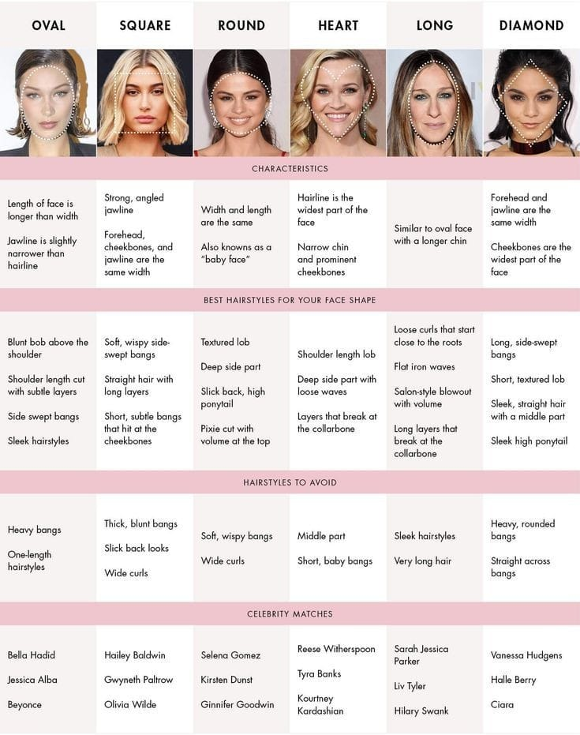
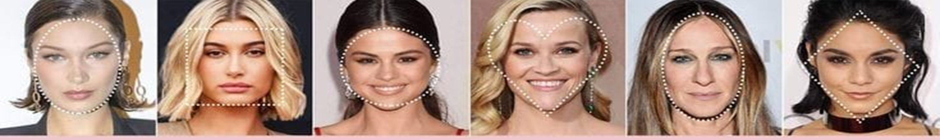
RECOMENDATIONS
FACESHAPES
OVAL
 | SQUARE | ROUND | HEART | OBLONG
 | Length : Medium or Long Styles : Straight hair with long layers Soft waves Shoulder length bob Tousled lob Long and voluminous waves Blunt chin length bob | Length : Medium Styles : Textured lob Slick back high ponytail Side parted Pixie cut Long layers Symmetrical lengths Long bob Deep side part | Length : Long Styles : Shoulder length bob Deep side part with loose waves Layers upto collarbone Sleek lob Long blonde curled ends Short pixie | Length : Short or medium Styles : Loose curls Flat iron waves Long layers Wavy shoulder length bob Bob with volume Tousled ponytail Deep side part
Length :
Medium or Short.
Styles :
Blunt bob above the shoulder
Long layers
Shoulder length cut
Side parted lob
Sleek hairstyles
Pixie cut
Armpit length haircut with layered ends
HAIRSTYLES

Slide 41
 | OVAL | SQUARE | ROUND | HEART | OBLONG
 | Bangs : Side swept bangs Baby bangs | Bangs : Soft , wispy side swept bangs Long layered bangs | Bangs : Blunt bangs Thick bangs | Bangs : Curtain bangs Wispy bangs | Bangs : Side swept bangs Curtain bangs
EYE GLASSES | Round Cat eye Rectangle Wayfare Square Oval Aviators Geometric browline | Round Cat eye Wayfare Aviators Browline Oval | Rectangle Square Aviators geometric | Cat eye Rectangle Wayfare Browline Oval | Wayfare Browline Oval Aviators Round Geometric
CONTOUR AND HIGHLIGHT | Contour under your cheekbones and on the outer edges of your forehead. | Add length to your face by applying bronzer on the outer corners of your forehead and jawline | Apply bronzer to your hairline and jawline | Contour on the centre of your jawline and on the temples, cheekbones to take some width of upper face. | Contour to the top and bottom: the hairline and just below the chin.

Slide 42
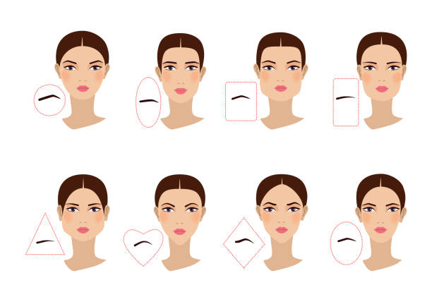
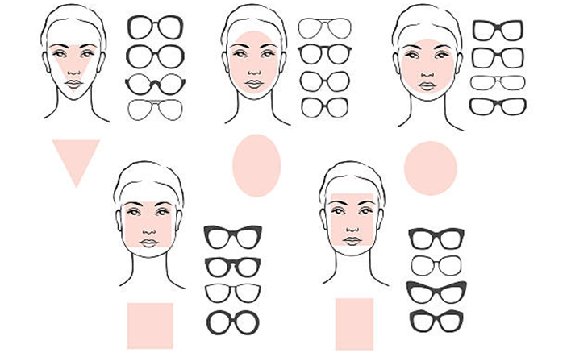
 | OVAL | SQUARE | ROUND | HEART | OBLONG
 | Highlight on your highest points like cheekbones, brow bone, bridge of nose and chin. | Highlight your cheekbones, centre of forehead, nose tip and chin. | Highlight on your forehead, chin and cheekbones. | Highlight the tip of your nose, forehead and cupid’s bow. | Highlight under the eyes in a triangle shape sweeping it out towards your ears
EYEBROW SHAPE | Soft angles and shallow arches. | A strong brow with a defined arch. | A lifted , angled arch. | High arches(short heart) ,low arches(longer heart). | flat eyebrow.

Slide 43
IMPLEMENTATION
Implementation Steps:
Data collection: Gather images of human faces.
Data preprocessing: Involves image resizing , rgb to grey conversion and noise filtering.
Feature Extraction: Extracting features from the image.
Classification: Using Convolutional Neural Network(CNN) we classify the images.
Evaluation: Evaluate the model's performance using metrics like accuracy.
Deployment: Deploy the model as a web application.

Slide 44
IMPLEMENTATION
1.Pseudocode for Picture Uploading
Input image is obtained from the dataset which represents the Human face.
Step 1: Click on upload
Step 2: Read the image from dataset image A=cv2.imread(args[“first”])
Step 3: Display the shape of the human face on the webpage
Step 4: Shows the shape of the human face in the dialog box
2.Pseudocode for Converting RGB image to Gray
In this section the RGB image is converted to gray image because it is easy to perform the operations such as median filtering, thresholding and highpass filtering.
Step 1: Converting RGB to Gray
Step 2: Show the window to display the image
Step 3: Display the image in the window
Step 4: Multiply each plane with a threshold value
Step5: Gray_pixel = (R_plan * R_thresh) + (G_plan * G_thresh) + (B_plan * B_thresh);

Slide 45
3.Pseudocode for Thresholding
Image thresholding is a simple, yet effective, way of partitioning an image into a foreground and background. This image analysis technique is a type of image segmentation that isolates objects by converting grayscale images into binary images.
Step 1: for i:=1 to 300*300 pixels
Step 2: if new_im(i) <T
Step 3: Change to black, and consider as obstacle set new_im(i)=0
Step 4: Change to white, and consider as free space else set new_im(i)=1
4.Pseudocode for Highpass Filtering
A high-pass filter can be used to make an image appear sharper. These filters emphasize fine details in the image- which is exactly the opposite of low pass filters. High pass filtering works inexactly the same way as a low pass filter except that it uses a different convolution kernel. Unfortunately, while low-pass filtering smooths out noise, high-pass only does the opposite by amplifying noise. However, if the original image is not too noisy- this is avoided to an extent.
Step1: Displays the high contrast version of original image.
Step2: Make a copy of the original image. Initialize color[ ][ ] retval←copy(original)
Step3: Blur the copy of original image. set color[ ][ ]blurred ←gaussianBlur(original)

Slide 46
Pseudocode for Highpass Filtering (Contd.)
Step 4:Subtarct the blur image from original image.color[][] highpass difference(original,blured)
Step 5: Add the unsharp mask to original image to get sharpened image.
Step 6: Run a loop for the entire rows and columns for row=0 to original. length repeat until for col=0 to original[row].length repeat until initialize color origColor←original[row][col] initializecontrastColor←highContrast[row][col] set color difference←contrast color - origColor end for end for

Slide 47
Pseudocode
Importing modules
import shutil
import os
import sys
from flask import Flask, render_template, request
import cv2 # working with, mainly resizing, images
import numpy as np # dealing with arrays
import os # dealing with directories
from random import shuffle # mixing up or currently ordered data that might lead our network astray in training.
from tqdm import \
tqdm # a nice pretty percentage bar for tasks. Thanks to viewer Daniel BA1/4hler for this suggestion
import tflearn
from tflearn.layers.conv import conv_2d, max_pool_2d
from tflearn.layers.core import input_data, dropout, fully_connected
from tflearn.layers.estimator import regression
import tensorflow as tf
import matplotlib.pyplot as plt

Slide 48
2.Training the data
import cv2
import numpy as np
import os
from random import shuffle
from tqdm import tqdm
TRAIN_DIR = 'training_set'
TEST_DIR = 'testing_set'
IMG_SIZE = 50
LR = 1e-3
MODEL_NAME = 'faceshape-{}-{}.model'.format(LR, '2conv-basic')
def label_img(img):
word_label = img[0]
print("first letter : {} \n image name : {} ".format(word_label,img))
if word_label == 'h':
print('heart shape')
return [1,0,0,0,0]

Slide 49
elif word_label == 'o':
print('oblong shape ')
return [0,1,0,0,0]
elif word_label == 'v':
print('oval shape ')
return [0,0,1,0,0]
elif word_label == 'r':
print('round shape ')
return [0,0,0,1,0]
elif word_label == 's':
print('sqare shape ')
return [0,0,0,0,1]
def create_train_data():
training_data = []
for img in tqdm(os.listdir(TRAIN_DIR)):
label = label_img(img)
print('##############')
print(label)
path = os.path.join(TRAIN_DIR,img)
img = cv2.imread(path,cv2.IMREAD_COLOR)
img = cv2.resize(img, (IMG_SIZE,IMG_SIZE))
training_data.append([np.array(img),np.array(label)])
shuffle(training_data)
np.save('train_data.npy', training_data)
return training_data

Slide 50
def process_test_data():
testing_data = []
for img in tqdm(os.listdir(TEST_DIR)):
path = os.path.join(TEST_DIR,img)
img_num = img.split('.')[0]
img = cv2.imread(path,cv2.IMREAD_COLOR)
img = cv2.resize(img, (IMG_SIZE,IMG_SIZE))
testing_data.append([np.array(img), img_num])
shuffle(testing_data)
np.save('test_data.npy', testing_data)
return testing_data
train_data = create_train_data()
# If you have already created the dataset:
#train_data = np.load('train_data.npy')
process_data=process_test_data()
import tflearn
from tflearn.layers.conv import conv_2d, max_pool_2d
from tflearn.layers.core import input_data, dropout, fully_connected
from tflearn.layers.estimator import regression
import tensorflow as tf
#tf.reset_default_graph()
convnet = input_data(shape=[None, IMG_SIZE, IMG_SIZE, 3], name='input')

Slide 51
convnet = conv_2d(convnet, 32, 3, activation='relu')
convnet = max_pool_2d(convnet, 3)
convnet = conv_2d(convnet, 64, 3, activation='relu')
convnet = max_pool_2d(convnet, 3)
convnet = conv_2d(convnet, 128, 3, activation='relu')
convnet = max_pool_2d(convnet, 3)
convnet = conv_2d(convnet, 32, 3, activation='relu')
convnet = max_pool_2d(convnet, 3)
convnet = conv_2d(convnet, 64, 3, activation='relu')
convnet = max_pool_2d(convnet, 3)
convnet = fully_connected(convnet, 1024, activation='relu')
convnet = dropout(convnet, 0.8)
convnet = fully_connected(convnet, 5, activation='softmax')
convnet = regression(convnet, optimizer='adam', learning_rate=LR, loss='categorical_crossentropy', name='targets')
model = tflearn.DNN(convnet, tensorboard_dir='log')

Slide 52
if os.path.exists('{}.meta'.format(MODEL_NAME)):
model.load(MODEL_NAME)
print('model loaded!')
train = train_data[:-1]
test = train_data[:-10]
X = np.array([i[0] for i in train]).reshape(-1,IMG_SIZE,IMG_SIZE,3)
Y = [i[1] for i in train]
print(X.shape)
test_x = np.array([i[0] for i in test]).reshape(-1,IMG_SIZE,IMG_SIZE,3)
test_y = [i[1] for i in test]
print(test_x.shape)
model.fit({'input': X}, {'targets': Y},n_epoch=100, validation_set=({'input': test_x}, {'targets': test_y}),snapshot_step=500, show_metric=True, run_id=MODEL_NAME)
model.save(MODEL_NAME)

Slide 53
2.Testing the data
import shutil
import os
import sys
from flask import Flask, render_template, request
import cv2 # working with, mainly resizing, images
import numpy as np # dealing with arrays
import os # dealing with directories
from random import shuffle # mixing up or currently ordered data that might lead our network astray in training.
from tqdm import \
tqdm # a nice pretty percentage bar for tasks. Thanks to viewer Daniel BA1/4hler for this suggestion
import tflearn
from tflearn.layers.conv import conv_2d, max_pool_2d
from tflearn.layers.core import input_data, dropout, fully_connected
from tflearn.layers.estimator import regression
import tensorflow as tf
import matplotlib.pyplot as plt
# global b
app = Flask(__name__)
@app.route('/')
def index():
return render_template('home.html')

Slide 54
@app.route('/image', methods=['GET', 'POST'])
def image():
if request.method == 'POST':
dirPath = "static/images"
fileList = os.listdir(dirPath)
for fileName in fileList:
os.remove(dirPath + "/" + fileName)
fileName=request.form['filename']
dst = "static/images"
shutil.copy("testing_set\\"+fileName, dst)
image = cv2.imread("testing_set\\"+fileName)
gray_image = cv2.cvtColor(image, cv2.COLOR_BGR2GRAY)
cv2.imwrite('static/gray.jpg', gray_image)
image=np.zeros((300,300),dtype="uint8")
retval2,threshold2 = cv2.threshold(gray_image,125,255,cv2.THRESH_BINARY+cv2.THRESH_OTSU)
cv2.rectangle(threshold2,(10,10),(40,40),(0, 0, 255), 1)
cv2.imwrite('static/threshold.jpg', threshold2)
verify_dir = 'static/images'
IMG_SIZE = 50
LR = 1e-3
MODEL_NAME = 'faceshape-{}-{}.model'.format(LR, '2conv-basic')

Slide 55
##MODEL_NAME='keras_model.h5'
def process_verify_data():
verifying_data = []
for img in os.listdir(verify_dir):
path = os.path.join(verify_dir, img)
img_num = img.split('.')[0]
img = cv2.imread(path, cv2.IMREAD_COLOR)
img = cv2.resize(img, (IMG_SIZE, IMG_SIZE))
verifying_data.append([np.array(img), img_num])
np.save('verify_data.npy', verifying_data)
return verifying_data
verify_data = process_verify_data()
#verify_data = np.load('verify_data.npy')
tf.compat.v1.reset_default_graph()
#tf.reset_default_graph()
convnet = input_data(shape=[None, IMG_SIZE, IMG_SIZE, 3], name='input')
convnet = conv_2d(convnet, 32, 3, activation='relu')
convnet = max_pool_2d(convnet, 3)
convnet = conv_2d(convnet, 64, 3, activation='relu')
convnet = max_pool_2d(convnet, 3)

Slide 56
convnet = conv_2d(convnet, 128, 3, activation='relu')
convnet = max_pool_2d(convnet, 3)
convnet = conv_2d(convnet, 32, 3, activation='relu')
convnet = max_pool_2d(convnet, 3)
convnet = conv_2d(convnet, 64, 3, activation='relu')
convnet = max_pool_2d(convnet, 3)
convnet = fully_connected(convnet, 1024, activation='relu')
convnet = dropout(convnet, 0.8)
convnet = fully_connected(convnet, 5, activation='softmax')
convnet = regression(convnet, optimizer='adam', learning_rate=LR, loss='categorical_crossentropy', name='targets')
model = tflearn.DNN(convnet, tensorboard_dir='log')
if os.path.exists('{}.meta'.format(MODEL_NAME)):
model.load(MODEL_NAME)
print('model loaded!')
fig = plt.figure()
accuracy=""
str_label=" "
suggestions=" "
for num, data in enumerate(verify_data):

Slide 57
img_num = data[1]
img_data = data[0]
y = fig.add_subplot(3, 4, num + 1)
orig = img_data
data = img_data.reshape(IMG_SIZE, IMG_SIZE, 3)
# model_out = model.predict([data])[0]
model_out = model.predict([data])[0]
print(model_out)
print('model {}'.format(np.argmax(model_out)))
if np.argmax(model_out) == 0:
str_label = 'HEART SHAPE'
print("The predicted image of the face has HEART SHAPE with a accuracy of {} %".format(model_out[0]*100))
accuracy = "The predicted image of the face has HEART SHAPE with a accuracy of {} %".format(model_out[0]*100)
suggestions="HAIRSTYLES: Length :Long.\n Styles :Shoulder length bob, deep side part with loose waves, layers upto collarbone, sleek lob,
long blonde curled ends, short pixie, Bangs:curtain bangs, wispy bangs \n\n EYE GLASSES : Cat eye, Rectangle, Wayfare, Oval,
browline \n\n CONTOUR AND HIGHLIGHT:contour on the center of your jawline and on the temples,cheekbones to take some
width of upperface \n hightlight the tip of your nose,forehead and cupid's bow \n\n EYEBROW SHAPE:high arches(short heart),
low arches(longer heart)"
A=float(model_out[0])
B=float(model_out[1])
C=float(model_out[2])
D=float(model_out[3])
E=float(model_out[4])

Slide 58
dic={'heart':A,'oblong':B,'oval':C,'round':D,'sqaure':E}
algm = list(dic.keys())
accu = list(dic.values())
fig = plt.figure(figsize = (5, 5))
plt.bar(algm, accu, color ='maroon', width = 0.3)
plt.xlabel("Comparision")
plt.ylabel("Accuracy Level")
plt.title("Accuracy Comparision between face shapes....")
plt.savefig('static/matrix.png')
elif np.argmax(model_out) == 1:
str_label = 'oblong'
print("The predicted image of the face has oblong shape with a accuracy of {} %".format(model_out[1]*100))
accuracy = "The predicted image of the face has oblong shape with a accuracy of {} %".format(model_out[1]*100)
suggestions="HAIRSTYLES: Length :Short or Medium.\n Styles :Loss curles, flat iron waves, long layers, wavy shoulder length bob,
bob with volume, tousled ponytail, deep side part \n Bangs:curtain bangs, side swept bangs \n\n EYE GLASSES : Wayfare, Oval, browline,
aviators, round, geometric \n\n CONTOUR AND HIGHLIGHT:contour to the top and bottom: the hairline and just below the chin \n
hightlight under the eyes in a triangle shape sweeping it out towards your ears \n\n EYEBROW SHAPE:flat eyebrow"
A=float(model_out[0])
B=float(model_out[1])
C=float(model_out[2])
D=float(model_out[3])
E=float(model_out[4])
dic={'heart':A,'oblong':B,'oval':C,'round':D,'sqaure':E}
algm = list(dic.keys())
accu = list(dic.values())
fig = plt.figure(figsize = (5, 5))

Slide 59
plt.bar(algm, accu, color ='maroon', width = 0.3)
plt.xlabel("Comparision")
plt.ylabel("Accuracy Level")
plt.title("Accuracy Comparision between face shapes....")
plt.savefig('static/matrix.png')
elif np.argmax(model_out) == 2:
str_label = 'oval'
print("The predicted image of the face has oval shape with a accuracy of {} %".format(model_out[2]*100))
accuracy = "The predicted image of the face has oval shape with a accuracy of {} %".format(model_out[2]*100)
suggestions="HAIRSTYLES: Length :Medium or Short.\n Styles :Blunt bob above the shoulder, Long layers, Shoulder length cut, side parted lob
sleek hairstyles, pixie cut, armpit length haircut with layered ends, Bangs:side swept bangs, baby bangs\n\n EYE GLASSES : Round, Cat eye,
Rectangle, Wayfare, Square, Oval, Aviators, Geometric, browline \n\n CONTOUR AND HIGHLIGHT:contour under your cheekbones and on
the outer edges of your forehead \n highlight on your highest points like cheekbones,brobone,bridge of your nose and chin \n\n
EYEBROW SHAPE:soft angles and shallow arches"
A=float(model_out[0])
B=float(model_out[1])
C=float(model_out[2])
D=float(model_out[3])
E=float(model_out[4])
dic={'heart':A,'oblong':B,'oval':C,'round':D,'sqaure':E}
algm = list(dic.keys())
accu = list(dic.values())
fig = plt.figure(figsize = (5, 5))
plt.bar(algm, accu, color ='maroon', width = 0.3)
plt.xlabel("Comparision")
plt.ylabel("Accuracy Level")
plt.title("Accuracy Comparision between face shapes....")
plt.savefig('static/matrix.png')
elif np.argmax(model_out) == 3:
str_label = 'round'
print("The predicted image of the face has round shape with a accuracy of {} %".format(model_out[3]*100))
accuracy = "The predicted image of the face has round shape with a accuracy of {} %".format(model_out[3]*100)
suggestions="HAIRSTYLES: Length :Medium \n Styles :textured lob, slick back high ponytail, side parted pixie cut, long layers, symmetrical lengths, long bob, deep side part, Bangs:blunt bangs, thick bangs \n EYE GLASSES : Rectangle, Square, Aviators, Geometric \n\n CONTOUR AND HIGHLIGTH:apply bronzer to your hairline and jawline \n highlight on your forehead,chin and cheekbones \n\n EYEBROW SHAPE:a lifted,angled arch"
A=float(model_out[0])
B=float(model_out[1])
C=float(model_out[2])
D=float(model_out[3])
E=float(model_out[4])
dic={'heart':A,'oblong':B,'oval':C,'round':D,'sqaure':E}
algm = list(dic.keys())
accu = list(dic.values())
fig = plt.figure(figsize = (5, 5))
plt.bar(algm, accu, color ='maroon', width = 0.3)
plt.xlabel("Comparision")
plt.ylabel("Accuracy Level")
plt.title("Accuracy Comparision between face shapes....")
plt.savefig('static/matrix.png')
elif np.argmax(model_out) == 4:
str_label = 'sqaure'
print("The predicted image of the face has sqaure shape with a accuracy of {} %".format(model_out[4]*100))
accuracy = "The predicted image of the face has sqaure shape with a accuracy of {} %".format(model_out[4]*100)
suggestions="HAIRSTYLES: Length :Medium or Long.\n Styles :straight hair with long layers, soft waves, shoulder length bob, tousled lob, long and voluminous waves, blunt chin bob \n\n Bangs:soft,wispy side swept bangs, long layered bangs \n\n EYE GLASSES : Round, Cat eye, Wayfare, Oval, Aviators, browline \n\n CONTOUR AND HIGHLIGHT:add length to your face by applying bronzer on the outer corners of your forehead and jawline \n highlight your cheekbones,center of forehead,nose tip and chin \n\n EYEBROW SHAPE:a strong bro with a defined arch"
A=float(model_out[0])
B=float(model_out[1])
C=float(model_out[2])
D=float(model_out[3])
E=float(model_out[4])
dic={'heart':A,'oblong':B,'oval':C,'round':D,'sqaure':E}
algm = list(dic.keys())
accu = list(dic.values())
fig = plt.figure(figsize = (5, 5))
plt.bar(algm, accu, color ='maroon', width = 0.3)
plt.xlabel("Comparision")
plt.ylabel("Accuracy Level")
plt.title("Accuracy Comparision between face shapes....")
plt.savefig('static/matrix.png')
return render_template('home.html', status=str_label,accuracy=accuracy,suggestions=suggestions ,ImageDisplay="http://127.0.0.1:5000/static/images/"+fileName,ImageDisplay1="http://127.0.0.1:5000/static/gray.jpg", ImageDisplay2="http://127.0.0.1:5000/static/threshold.jpg",ImageDisplay3="http://127.0.0.1:5000/static/matrix.png")
return render_template('home.html')
if __name__ == '__main__':
app.run(debug=True)

Slide 60
plt.title("Accuracy Comparision between face shapes....")
plt.savefig('static/matrix.png')
elif np.argmax(model_out) == 3:
str_label = 'round'
print("The predicted image of the face has round shape with a accuracy of {} %".format(model_out[3]*100))
accuracy = "The predicted image of the face has round shape with a accuracy of {} %".format(model_out[3]*100)
suggestions="HAIRSTYLES: Length :Medium \n Styles :textured lob, slick back high ponytail, side parted pixie cut, long layers, symmetrical
lengths, long bob, deep side part, Bangs:blunt bangs, thick bangs \n EYE GLASSES : Rectangle, Square, Aviators, Geometric \n\n
CONTOUR AND HIGHLIGTH:apply bronzer to your hairline and jawline \n highlight on your forehead,chin and cheekbones \n\n
EYEBROW SHAPE:a lifted,angled arch"
A=float(model_out[0])
B=float(model_out[1])
C=float(model_out[2])
D=float(model_out[3])
E=float(model_out[4])
dic={'heart':A,'oblong':B,'oval':C,'round':D,'sqaure':E}
algm = list(dic.keys())
accu = list(dic.values())
fig = plt.figure(figsize = (5, 5))
plt.bar(algm, accu, color ='maroon', width = 0.3)
plt.xlabel("Comparision")
plt.ylabel("Accuracy Level")
plt.title("Accuracy Comparision between face shapes....")
plt.savefig('static/matrix.png’)
elif np.argmax(model_out) == 4:

Slide 61
str_label = 'sqaure'
print("The predicted image of the face has sqaure shape with a accuracy of {} %".format(model_out[4]*100))
accuracy = "The predicted image of the face has sqaure shape with a accuracy of {} %".format(model_out[4]*100)
suggestions="HAIRSTYLES: Length :Medium or Long.\n Styles :straight hair with long layers, soft waves, shoulder length bob, tousled lob,
long and voluminous waves, blunt chin bob \n\n Bangs:soft,wispy side swept bangs, long layered bangs \n\n EYE GLASSES : Round, Cat eye,
Wayfare, Oval, Aviators, browline \n\n CONTOUR AND HIGHLIGHT:add length to your face by applying bronzer on the outer corners of your
forehead and jawline \n highlight your cheekbones,center of forehead,nose tip and chin \n\n EYEBROW SHAPE:a strong bro with a defined arch"
A=float(model_out[0])
B=float(model_out[1])
C=float(model_out[2])
D=float(model_out[3])
E=float(model_out[4])
dic={'heart':A,'oblong':B,'oval':C,'round':D,'sqaure':E}
algm = list(dic.keys())
accu = list(dic.values())
fig = plt.figure(figsize = (5, 5))
plt.bar(algm, accu, color ='maroon', width = 0.3)
plt.xlabel("Comparision")
plt.ylabel("Accuracy Level")
plt.title("Accuracy Comparision between face shapes....")
plt.savefig('static/matrix.png')
return render_template('home.html', status=str_label,accuracy=accuracy,suggestions=suggestions ,
ImageDisplay="http://127.0.0.1:5000/static/images/"+fileName,ImageDisplay1="http://127.0.0.1:5000/static/gray.jpg",
ImageDisplay2="http://127.0.0.1:5000/static/threshold.jpg",ImageDisplay3="http://127.0.0.1:5000/static/matrix.png")
return render_template('home.html')
if __name__ == '__main__':
app.run(debug=True)

Slide 62
UNIT TESTING TEST CASE 01
SYSTEM TESTING
S1# Test Case :-
1
Name of the Test :-
Uploading Image
Items Being Tested :-
Tested for uploading different images
Sample Input :-
Upload sample image
Expected output :-
Image should upload properly
Result :-
successful
Table 1:Test Case 01

Slide 63
UNIT TESTING TEST CASE 02
SYSTEM TESTING
Name of Test Detecting Oval face shape images
Items being tested Test for different Oval face shape images
Sample Input Tested for different images of Oval face shape
Expected output face shape and Recommendations should be displayed
Actual output Should Display the personalized recommendations for the face shape
Result Successful
Table 2:Test Case 02

Slide 64
SYSTEM TESTING
UNIT TESTING TEST CASE 03
Name of Test Detecting Oblong face shape images Items being tested Test for different Oblong face shape images Sample Input Tested for different images of Oblong face shape Expected output face shape and Recommendations should be displayed Actual output Should Display the personalized recommendations for the face shape
Result Successful
Table 3:Test Case 03

Slide 65
SYSTEM TESTING
UNIT TESTING TEST CASE 04
Name of Test Detecting Round face shape images Items being tested Test for different Oblong face shape images Sample Input Tested for different images of Oblong face shape Expected output face shape and Recommendations should be displayed Actual output Should Display the personalized recommendations for the face shape
Result Successful
Table 4:Test Case 04

Slide 66
SYSTEM TESTING
UNIT TESTING TEST CASE 05
Name of Test Detecting Square face shape images Items being tested test for different Square face shape images Sample Input Tested for different images of Square face shape Expected output face shape and Recommendations should be displayed Actual output Should Display the personalized recommendations for the face shape
Result Successful
Table 5:Test Case 05

Slide 67
SYSTEM TESTING
UNIT TESTING TEST CASE 06
Name of Test Detecting Heart face shape images Items being tested test for different Heart face shape images Sample Input Tested for different images of Heart face shape Expected output face shape and Recommendations should be displayed Actual output Should Display the personalized recommendations for the face shape
Result Successful
Table 6:Test Case 06

Slide 68
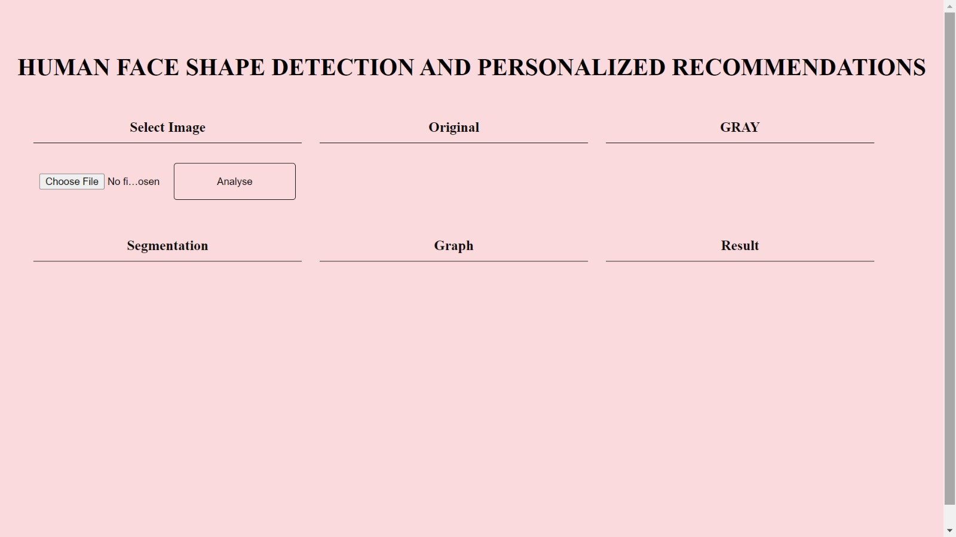
RESULTS AND ANALYSIS
SNAPSHOTS
Figure 17: front page

Slide 69
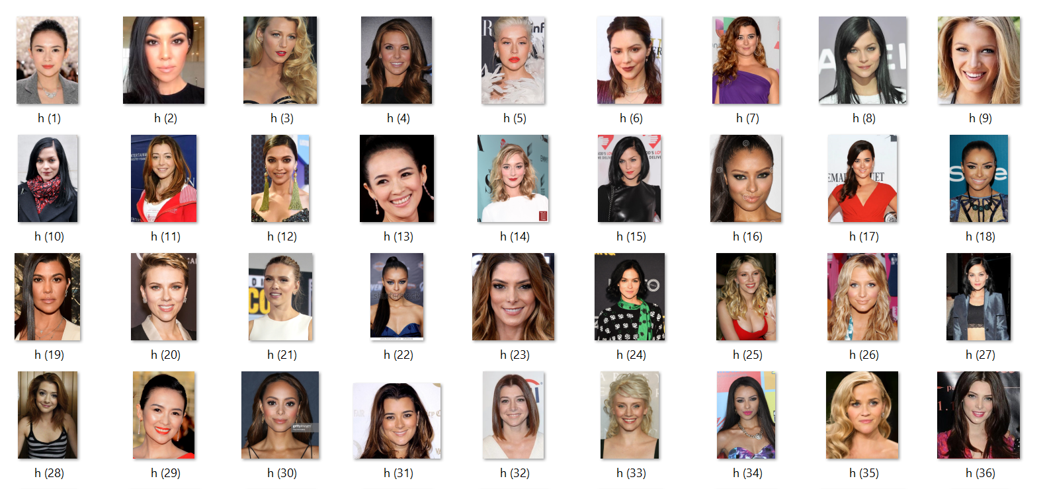
RESULTS AND ANALYSIS
Figure 18: datasets that are trained

Slide 70

RESULTS AND ANALYSIS
Figure 19: choose file from datasets

Slide 71
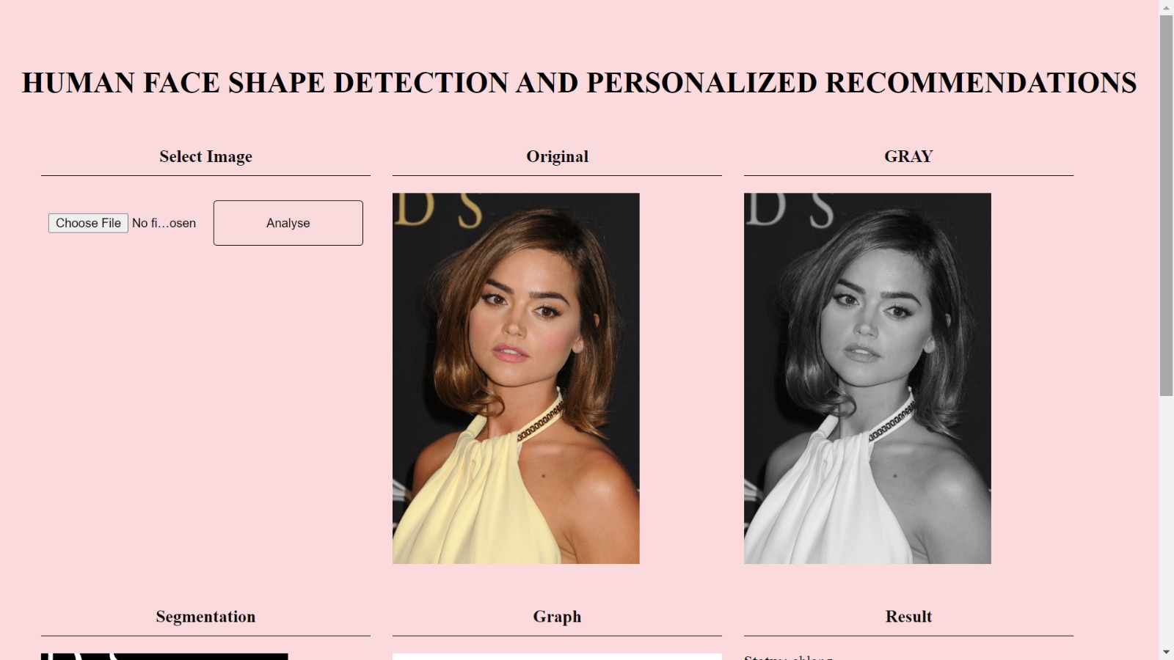
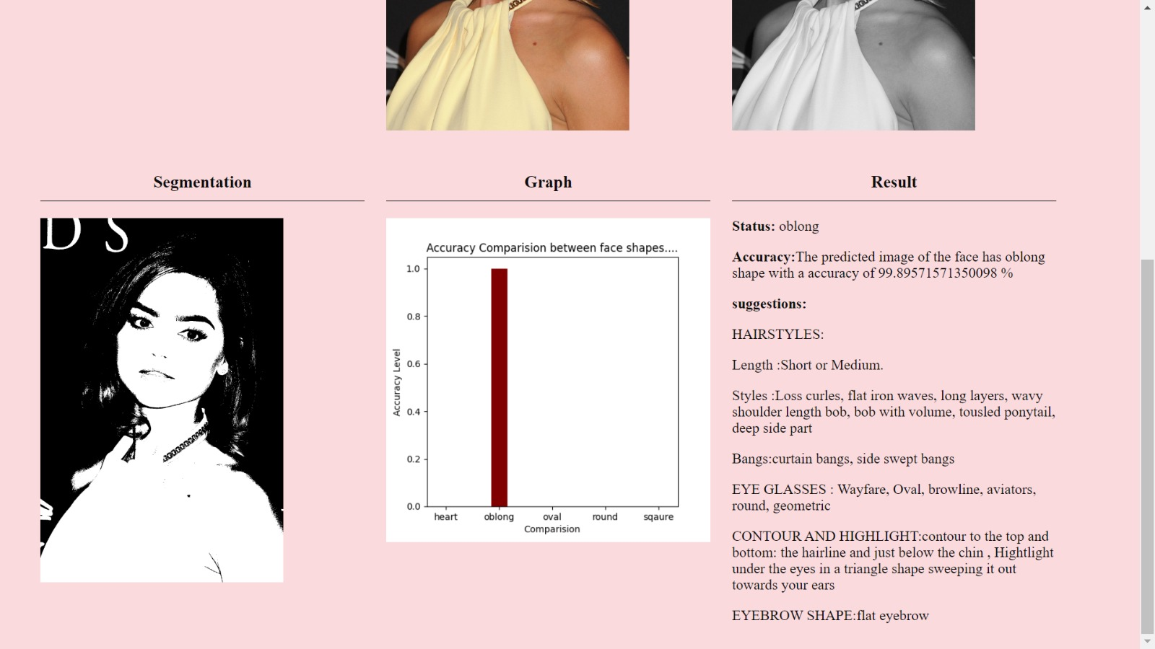
RESULTS AND ANALYSIS
Figure 20: selected face image and its Recommendations

Slide 72
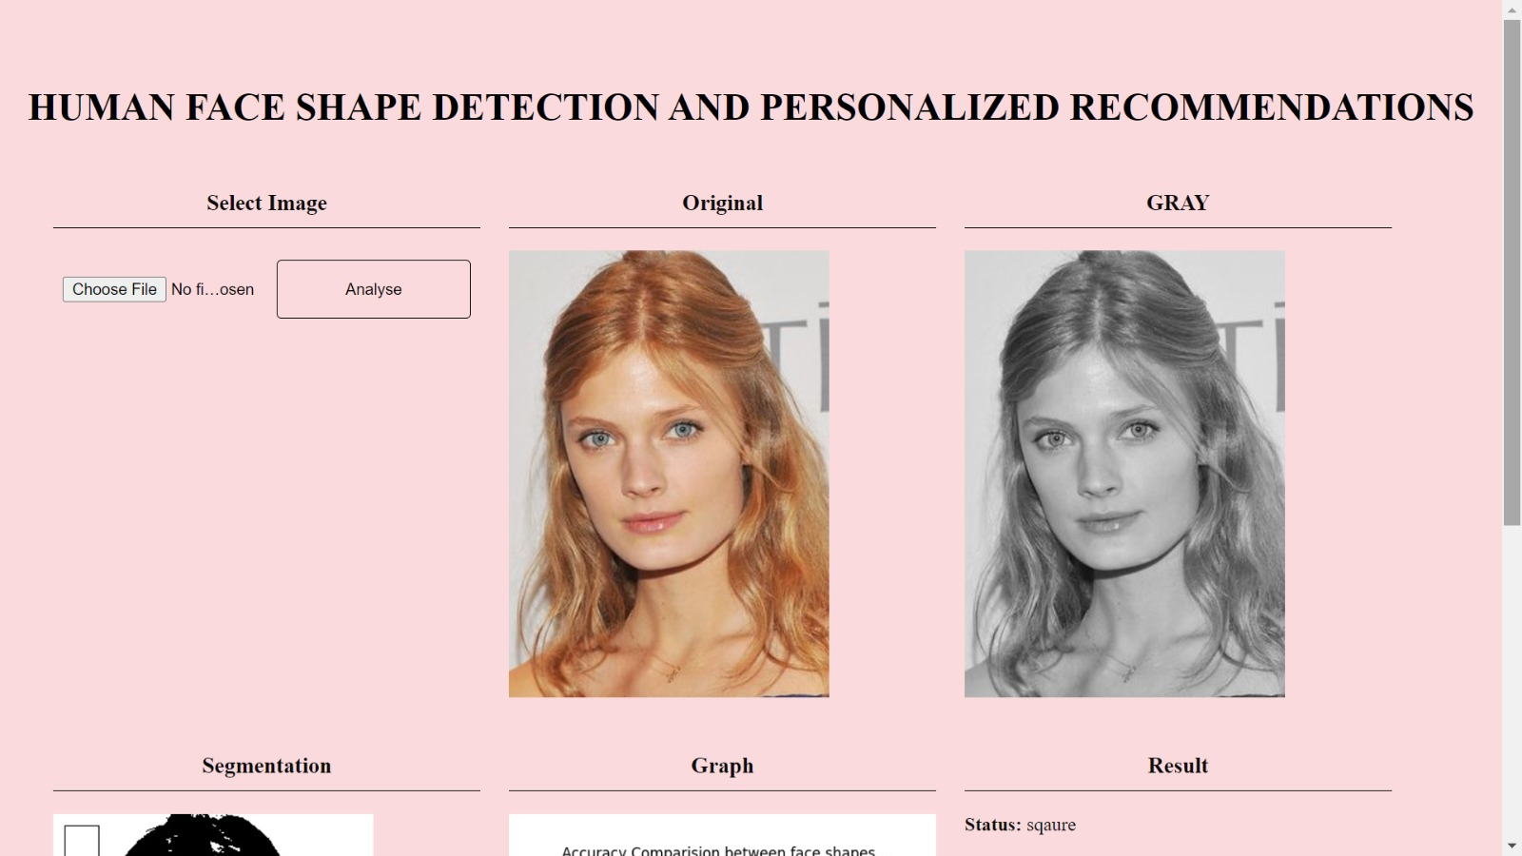
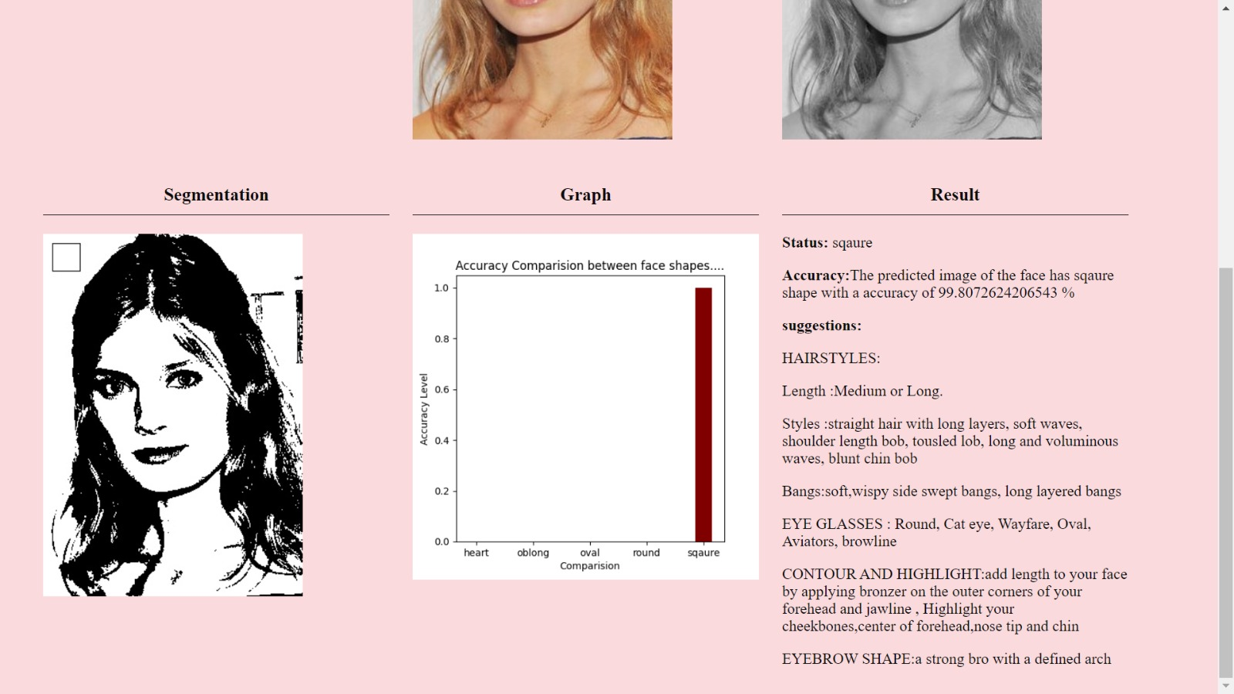
RESULTS AND ANALYSIS
Figure 21: selected face image and its Recommendations

Slide 73
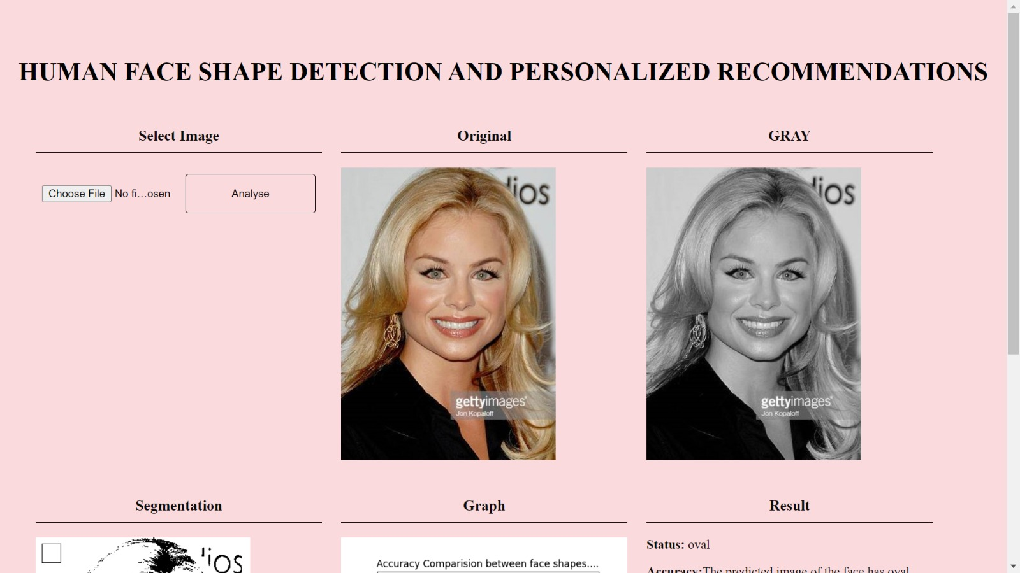
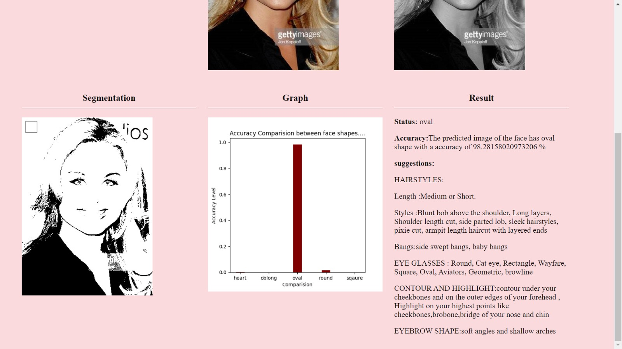
RESULTS AND ANALYSIS
Figure 22: selected face image and its Recommendations

Slide 74
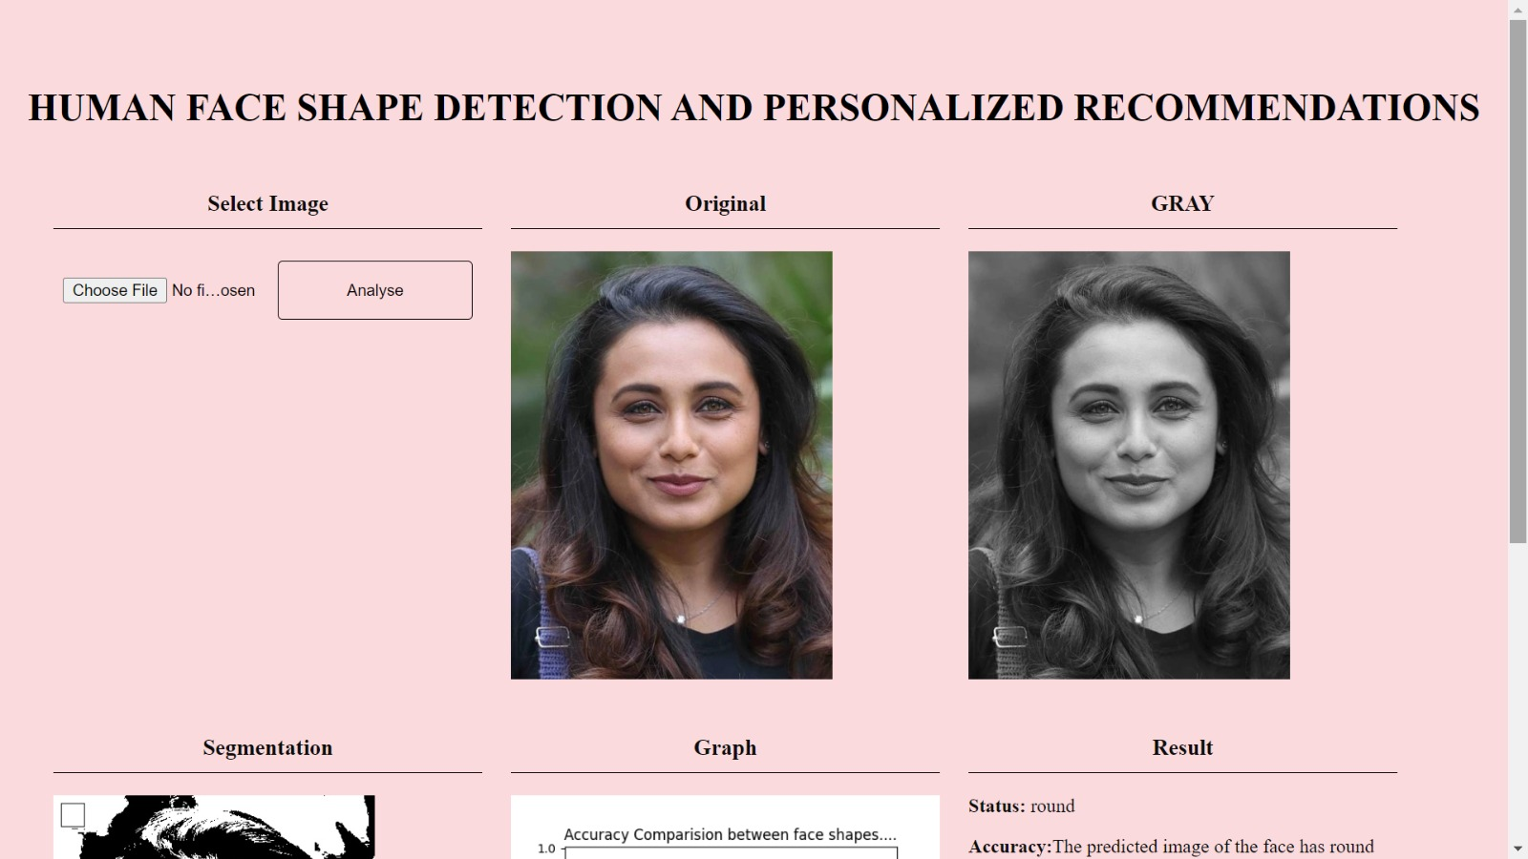
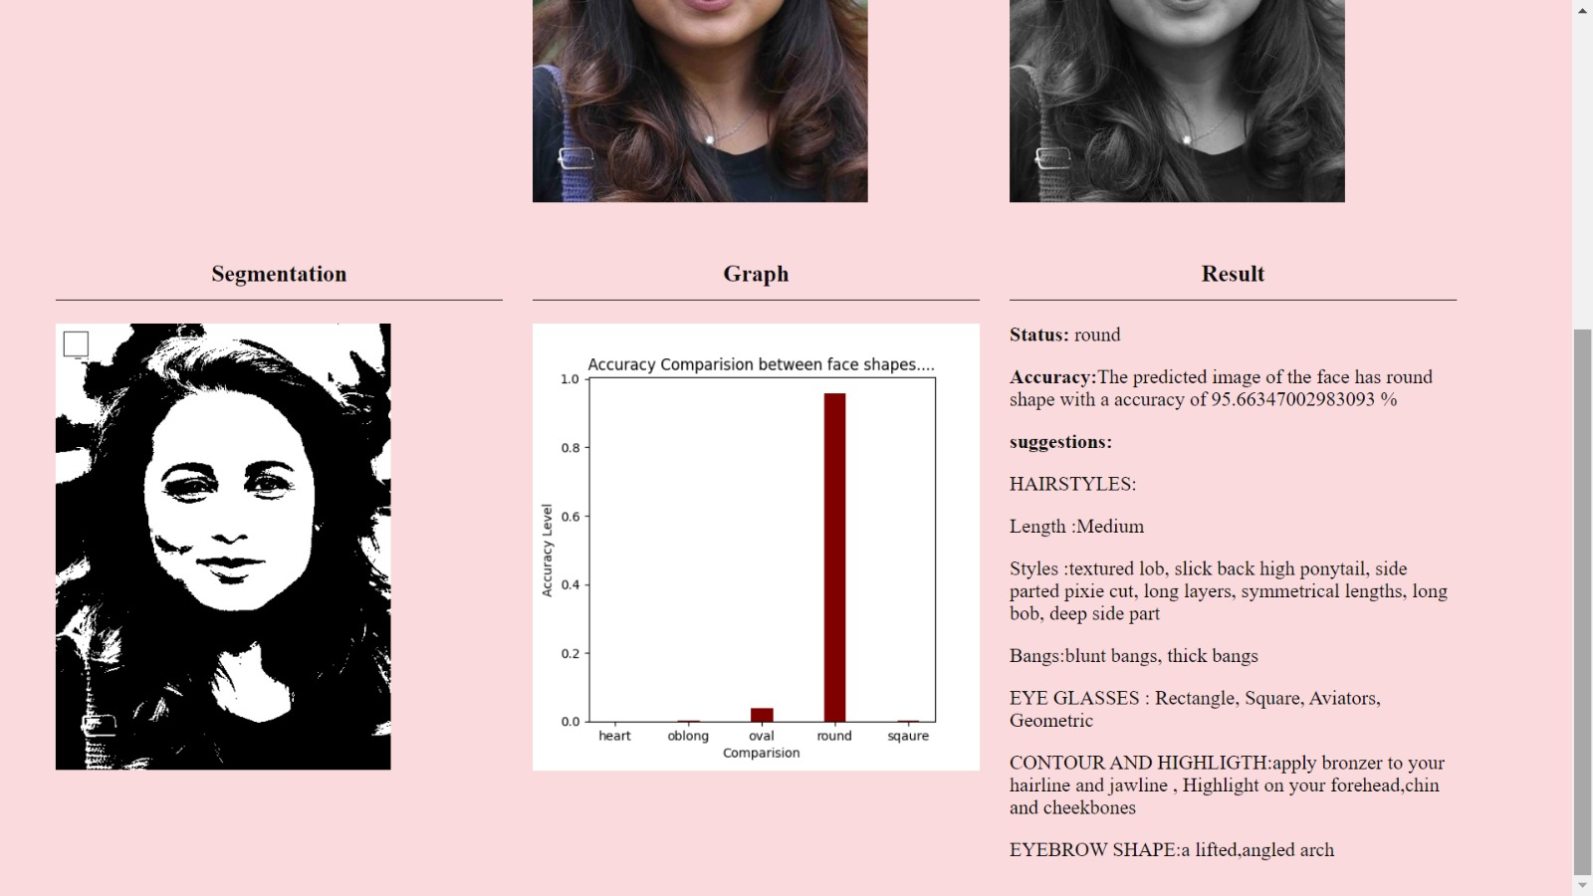
RESULTS AND ANALYSIS
Figure 23: selected face image and its Recommendations

Slide 75
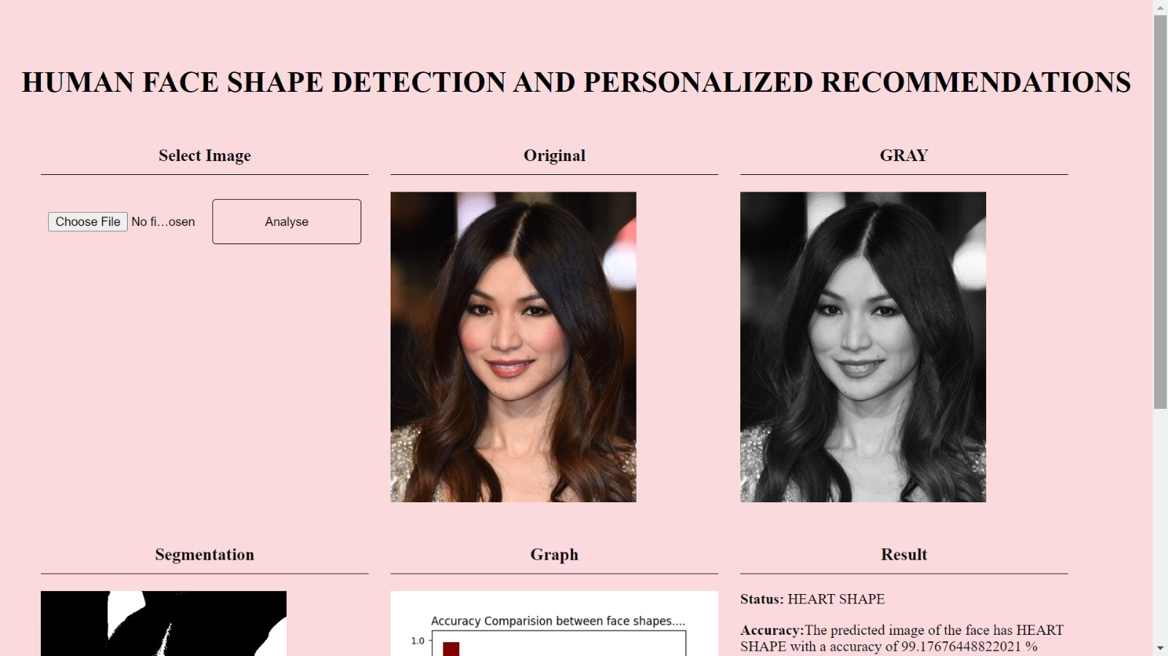
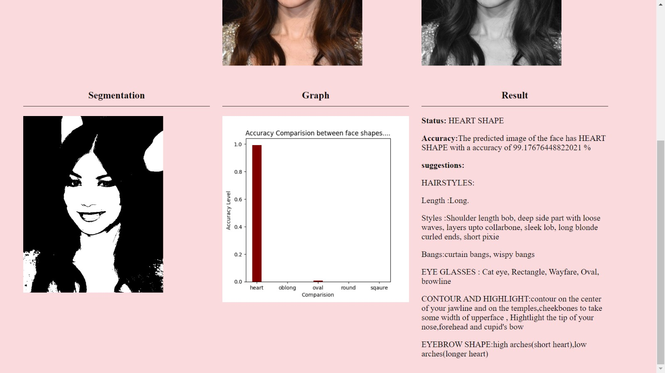
RESULTS AND ANALYSIS
Figure 24:selected face image and its Recommendations

Slide 76
CONCLUSION
The Face Shape Predictor and Recommendations project describes cutting-edge computer vision to deliver an innovative tool for accurately predicting face shapes and offering personalized beauty and fashion recommendations.
By prioritizing user privacy through robust security measures and incorporating privacy-preserving techniques, the project ensures ethical data handling.
The user-friendly interface facilitates seamless photo uploads, and visual simulations aid users in previewing suggested changes.
A feedback loop encourages continuous improvement, and educational content fosters a deeper understanding of personal aesthetics.
This comprehensive approach aims to not only enhance users' physical appearance but also boost their self-confidence, contributing to a positive and informed journey of self-expression.

Slide 77
FUTURE EHANCEMENT
Develop more accurate and robust facial recognition algorithms that can detect subtle variations in face shapes.
Incorporate 3D face modeling techniques to capture finer details of facial structures. This can provide a more comprehensive understanding of face shapes beyond 2D images, enabling better detection and analysis.
Implement real-time facial analysis algorithms that can detect changes in facial expressions, movements, and features.
Combine facial data with other modalities such as voice, body language, and biometric signals to create a more holistic user profile.
Utilize detected face shapes along with individual preferences, style, and skin tones to provide personalized fashion and beauty recommendations.

Slide 78
REFERENCES
[1] Bansode, N. and Sinha, P. (2016). Face shape classification based on region similarity, correlation and fractal dimensions. International Journal of Computer Science Issues (IJCSI), 13(1):24.
[2] Deng, Q., Luo, Y., and Ge, J. (2010). Dual threshold based unsupervised face image clustering. In 2010 he 2nd International Conference on Industrial Mechatronics and Automation, volume 1, pages 436–439. EEE.
[3] Hutten locher, D., Klanderman, G., and Rucklidge, W. (1993). Comparing images using the hausdorff distance. IEEE Transactions on Pattern Analysis and Machine Intelligence, 15(9):850–863.
[4] King, D. E. (2009). Dlib-ml: A machine learning toolkit. Journal of Machine Learning Research, 0:1755–1758.
[5] Pornthep Sarakon, Theekapun Charoenpong, S. C. (2014). Face shape classification from 3d human data by using svm. IEEE.

Slide 79
THANK YOU…!

